Slide 1
Game on! With Nativescript
Jen Looper | DEVREL @Telerik @jenlooper

Slide 2
$ whoami
Ph.D. … in Medieval French (13th century prose romance FTW)
Retrained!
Worked in startup, nonprofit, big corporate 14 yrs+
A lot of side projects – ladeezfirstmedia.com
Now DevRel@Telerik

Slide 3
What is NativeScript?

Slide 4



A runtime for building and running native iOS, Android, and (soon) Windows Phone apps with a single, JavaScript code base

Slide 5


Slide 6




!=
!=
No DOM
No cross compilation
!=
Direct access to native APIs in JS

Slide 7
Why Nativescript?
Skills reuse
Standards-based JavaScript, CSS, optionally TypeScript
Code reuse
npm modules, 3rd-party iOS and Android libraries
Easily use native APIs
No wrappers to access native APIs
Use native UI elements
Open source!

Slide 8
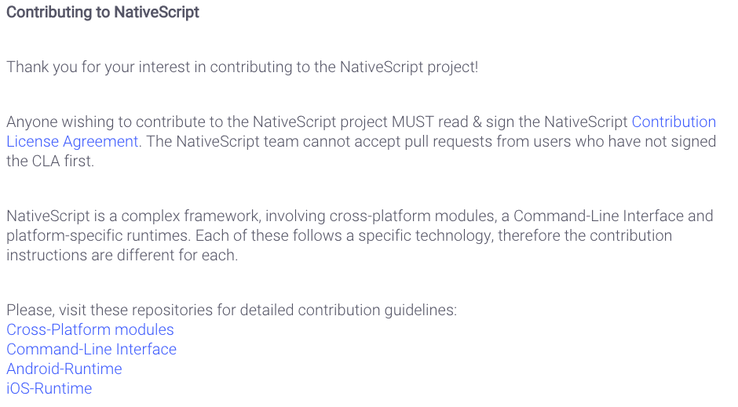
Contribute! (nativescript.org/contribute)

Slide 9






Slide 10
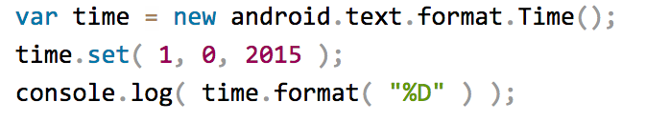
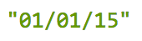
NativeScript Android example
Output:
Notes:
this JavaScript code instantiates a Java android.text.format.Time() object, calls its set() method, then logs the return value of its format() method, which is the string "01/01/15".

Slide 11
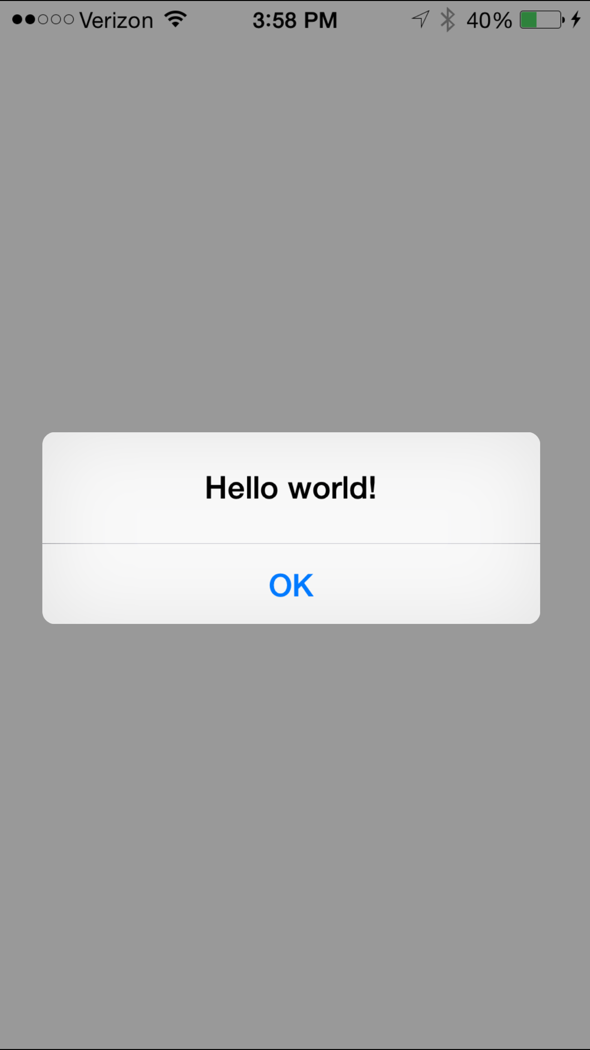
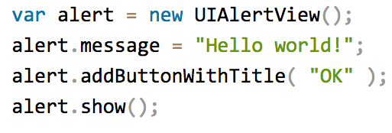
Nativescript ios example
Notes:
This JavaScript code instantiates an Objective-C UIAlertView class, sets its message property, and then calls its addButtonWithTitle() and show() methods. When you run a NativeScript iOS app with this code you'll see the alert "hello world!"

Slide 12
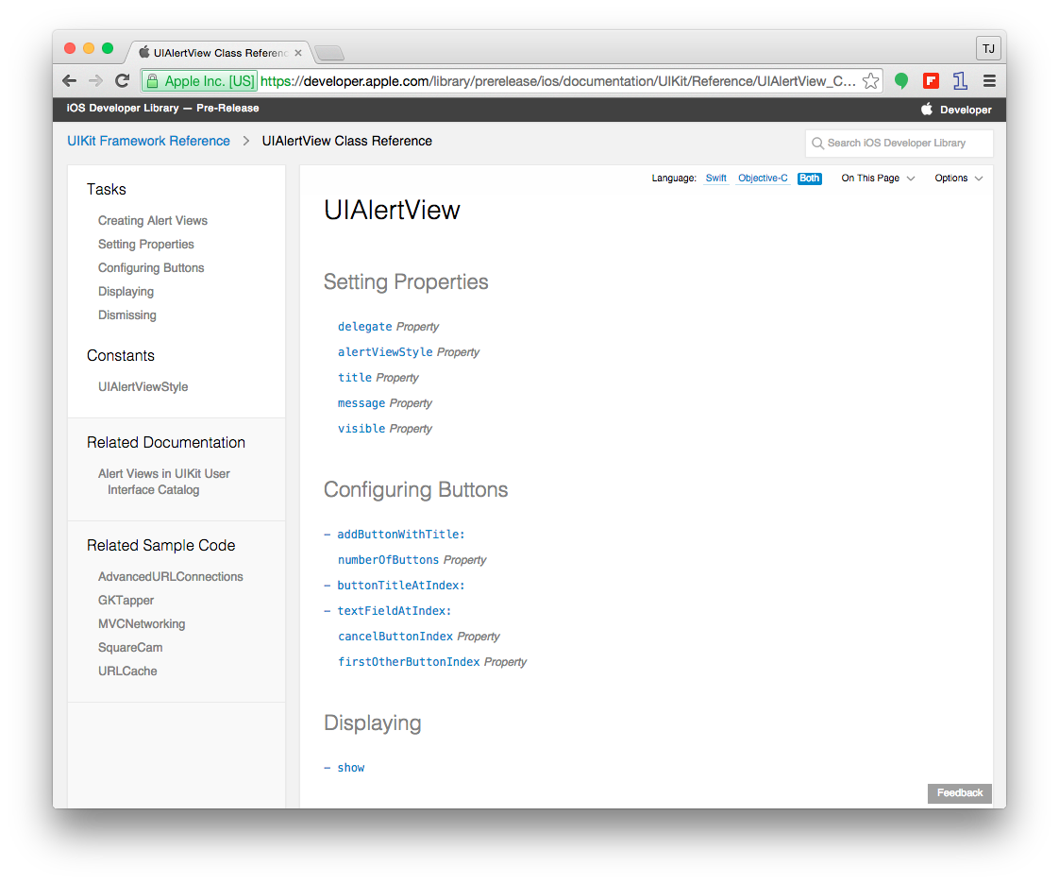
Notes:
Use native classes which you can find in the native documentation to craft your nativescript code

Slide 13

How does this work?

Slide 14
NativeScript and JS VMs
NativeScript runs JavaScript on a JavaScript VM
JavaScriptCore on iOS
V8 on Android
Notes:
NativeScript is a runtime that leverages platform-specific JavaScript engines (javascriptcore and V8)

Slide 15
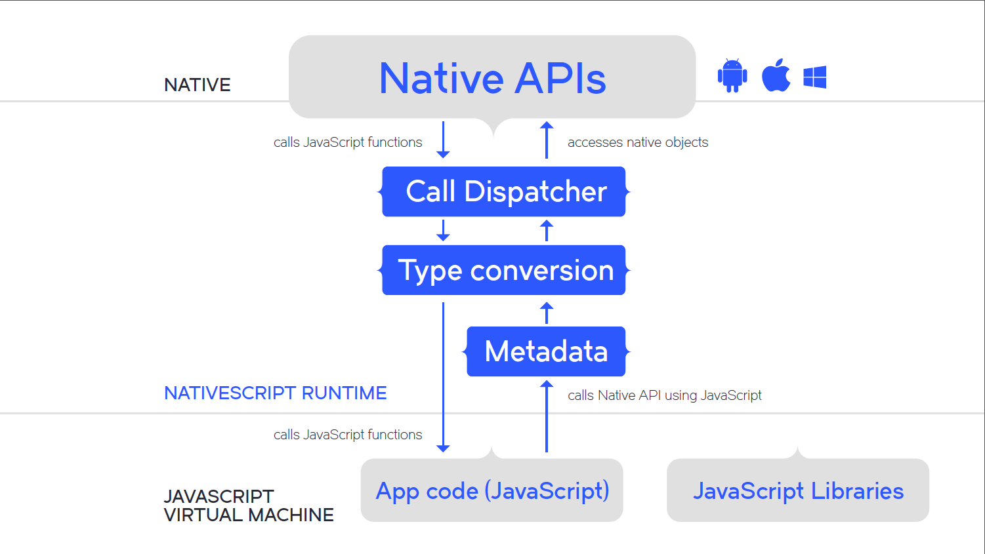

Slide 16
Runs on V8
Runs on JavaScriptCore

Slide 17
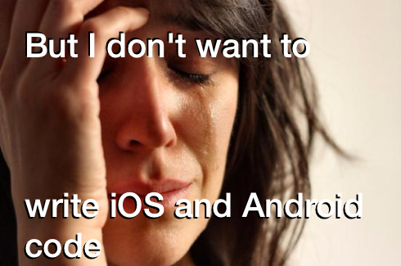

Slide 18
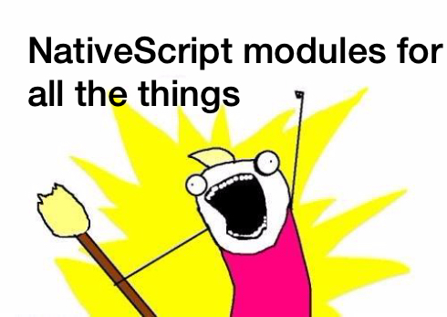

Slide 19
NativeScript modules
NativeScript-provided modules that provide cross-platform functionality.
There are dozens of them and they’re easy to write yourself.
NativeScript modules follow Node module’s conventions (CommonJS).

Slide 20
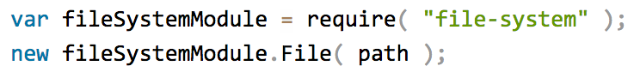
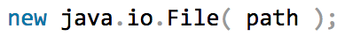
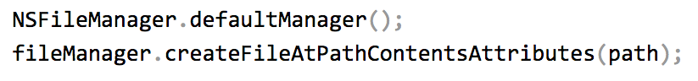
NativeScript file module
Notes:
this filesystem module allows you to pass through a path that you define as a parameter. On Android a new file will be created at that location, and on iOS we instantiate the NSFileManager as the default manager and tell it to create the file on that path. All with one require and one line of javascript.

Slide 21
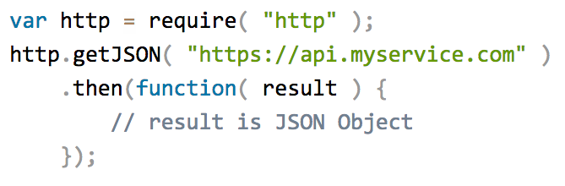
NativeScript http module
Notes:
the http module allows you to make http calls and return json results.

Slide 22
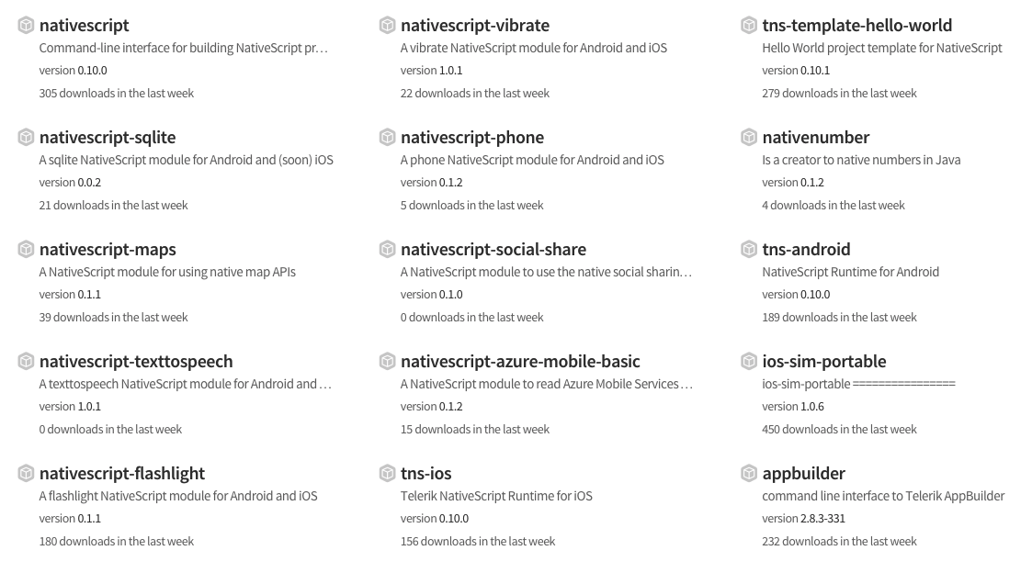
Community modules

Slide 23
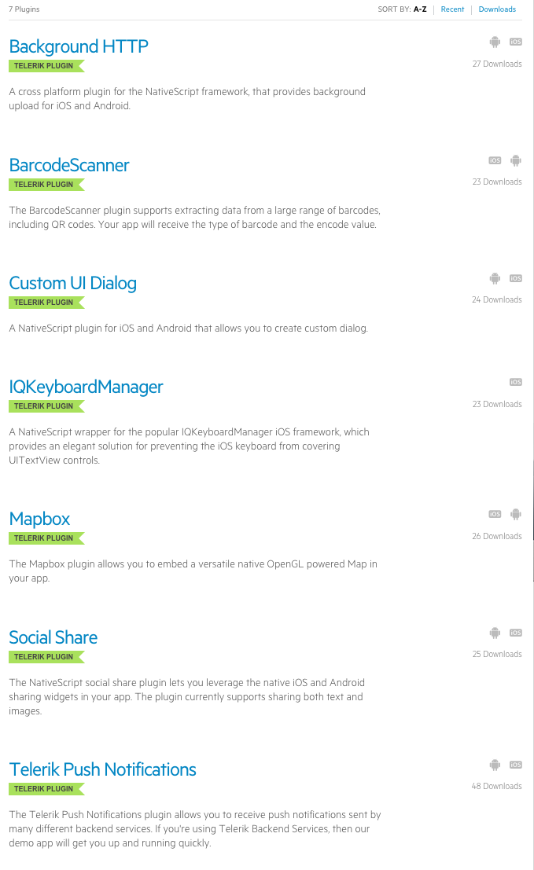
New! Plugin marketplace!

Slide 24

But how do I turn this into an app?

Slide 25

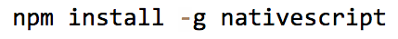
2 ways to use NativeScript
1)
2)

Slide 26
http://telerik.com/platform
Backend-as-a-service
Push notifications, cloud data, file storage, etc
Analytics
AppBuilder
Cloud builds (build iOS apps on Windows, Windows Phone apps on a Mac)
NativeScript debugging and tooling
Screen Builder (app scaffolding)
And more!

Slide 27
Telerik Appbuilder ide options
In-Browser Client
Visual Studio Extension
Sublime Text Package
Command-Line Interface

Slide 28
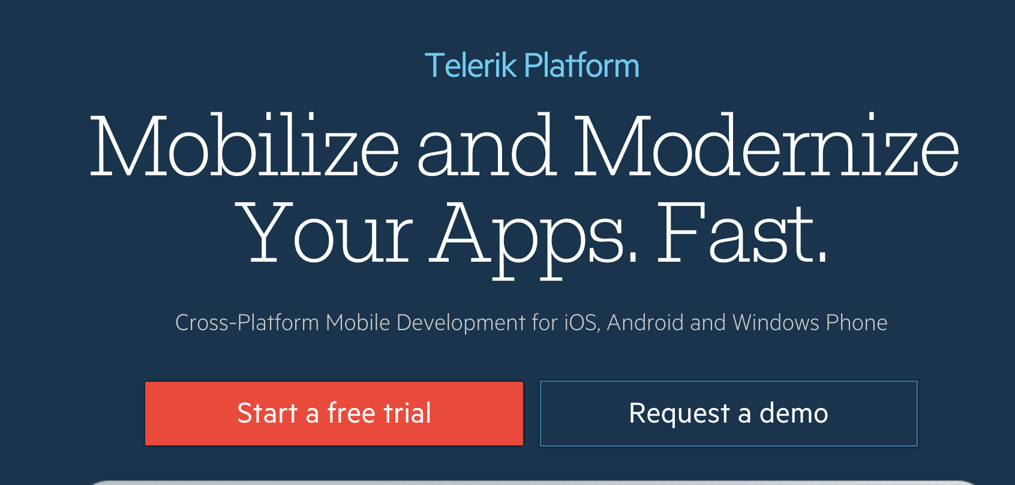

Slide 29
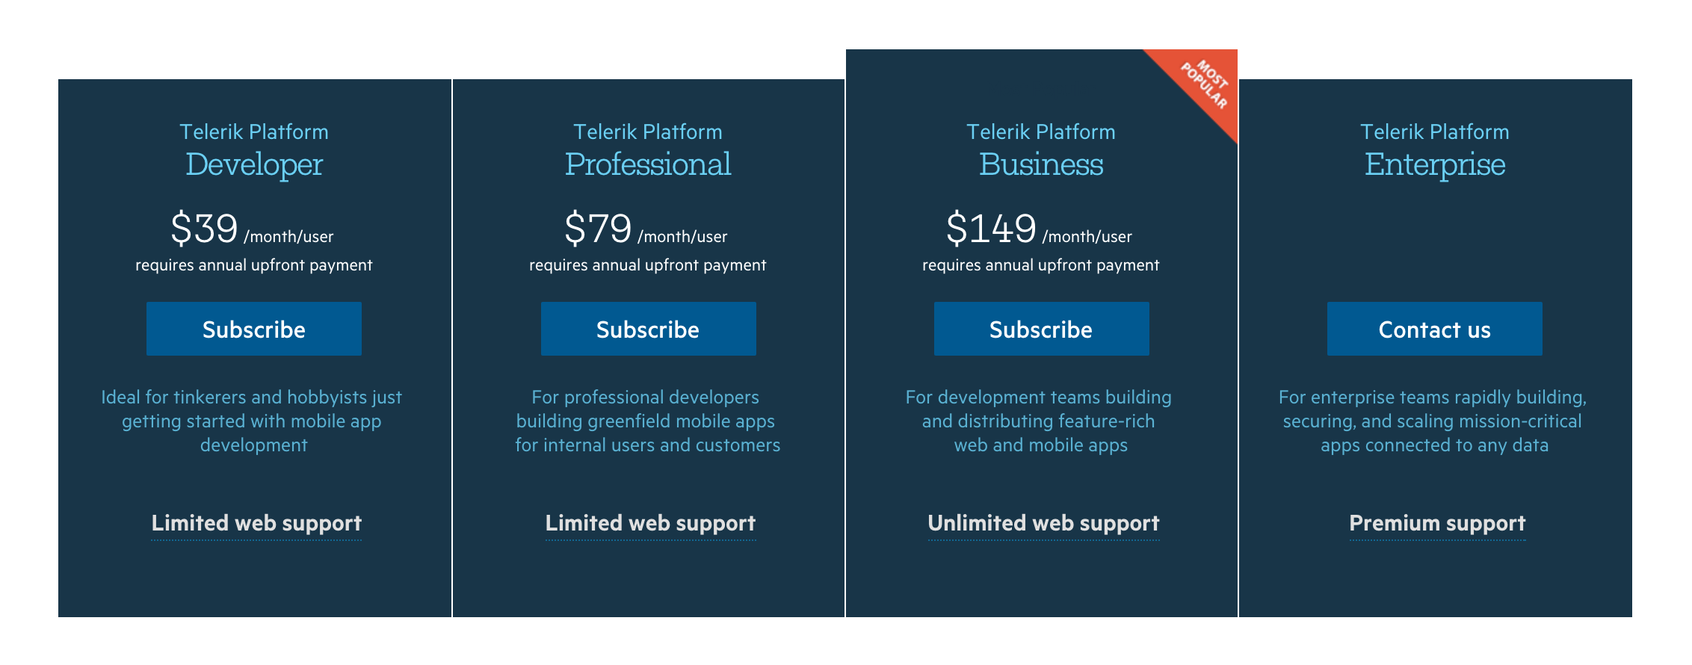
pricing
https://www.telerik.com/purchase/appbuilder
Notes:
free 30 day trial

Slide 30
Nativescript cli
Free and open source
https://github.com/nativescript/nativescript-cli

Slide 31
Nativescript cli requirements
https://github.com/nativescript/nativescript-cli#system-requirements
JDK, Apache Ant, Android SDK
Xcode, Xcode CLI tools, iOS SDK

Slide 32
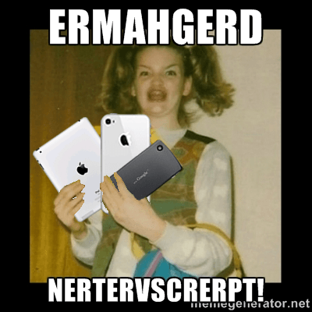
Learn more!
NativeScript Getting Started Guide: http://docs.nativescript.org/getting-started

Slide 33
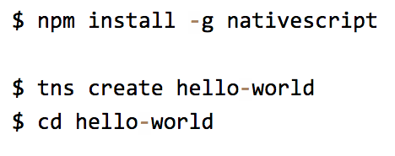
STARTING A NEW PROJECT

Slide 34
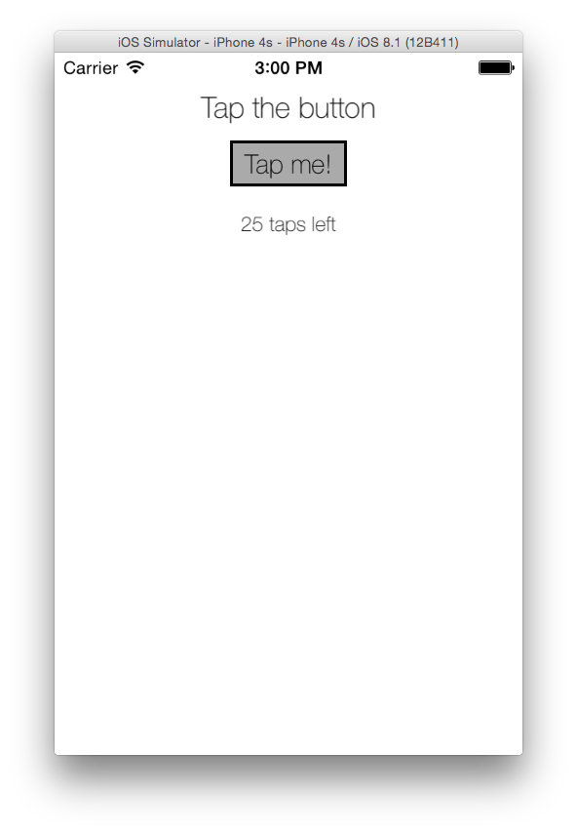
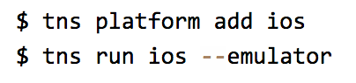
RUNNING ON IOS

Slide 35
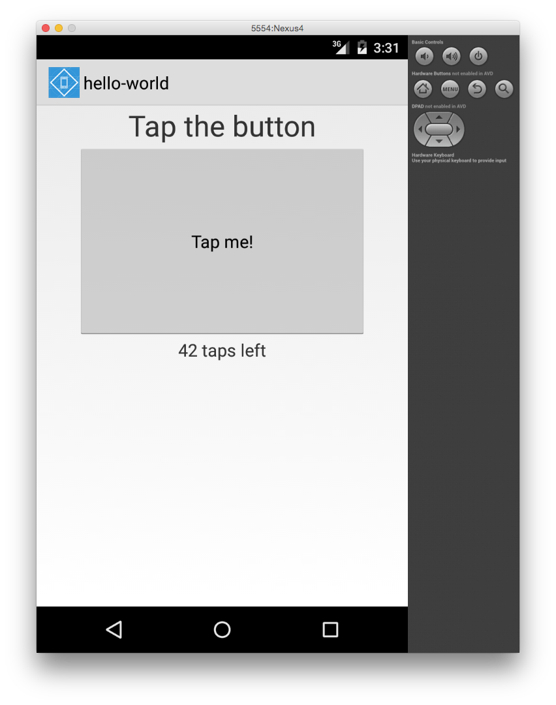
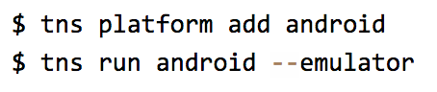
RUNNING ON android

Slide 36
Developer helps!
1. Livesync!
2. Sublime Text Settings to build
Cmd + B
3. Deploy to device
Notes:
Do this live – show livesync
Show sublime build script
Preferences > Browse Packages > User/nativescript.sublime-build

Slide 37
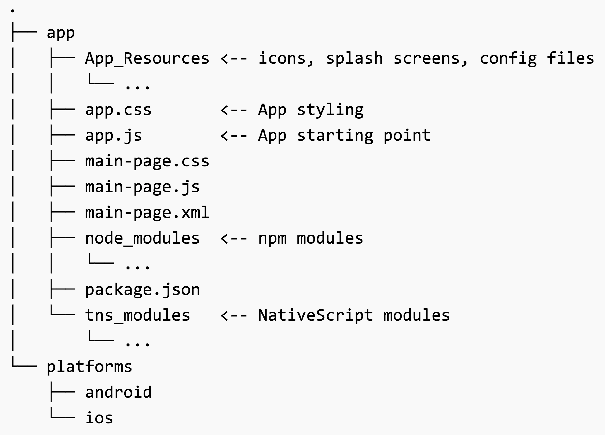
App structure

Slide 38
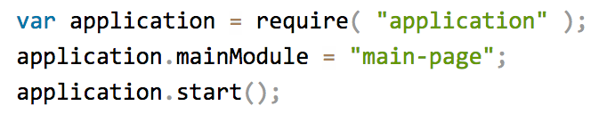
APP.JS

Slide 39
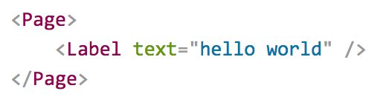
PAGES
XML markup structure
Elements (e.g. <Page>, <Label>) are NativeScript modules

Slide 40
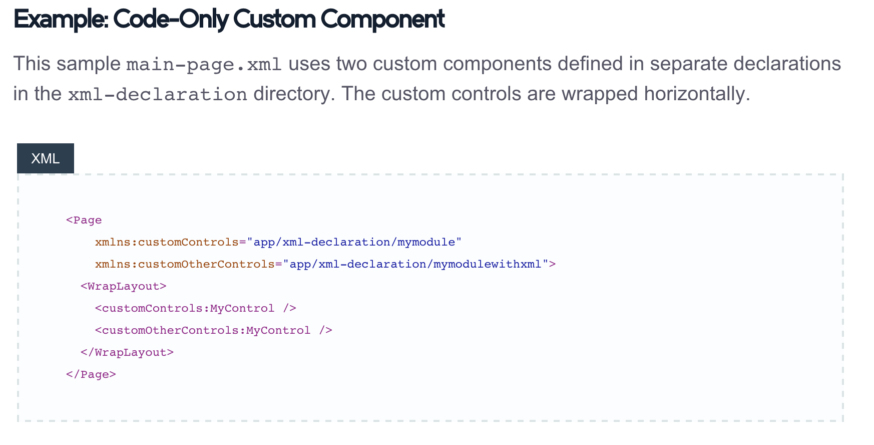
Custom xml components
http://docs.nativescript.org/ui-with-xml#custom-components

Slide 41
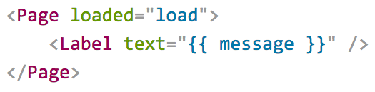
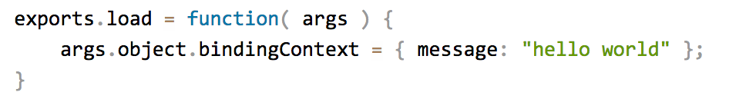
Data binding
Notes:
Use the load function to bind data to an xml element

Slide 42
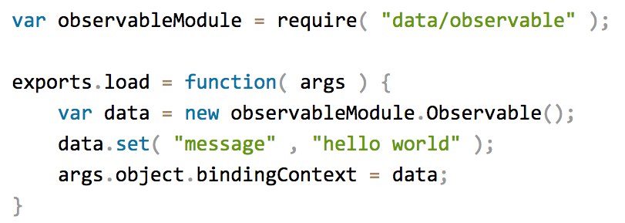
Data binding improved
Notes:
Or use the observable module to take care of it – mvvm people will feel comfortable.

Slide 43
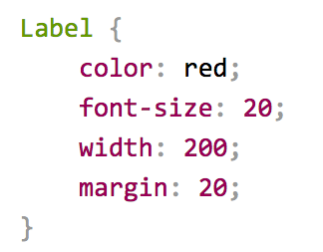
css
http://docs.nativescript.org/styling#supported-properties

Slide 44
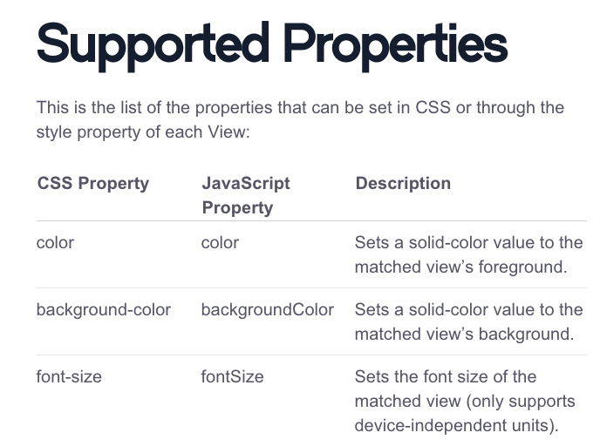
css

Slide 45

Let’s build something!

Slide 46
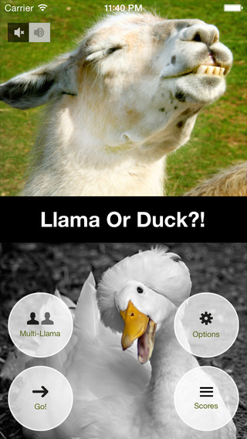
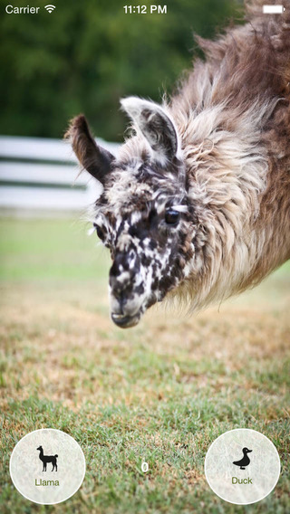
A game inspired by…
Show picture of llama or duck
Very quickly timeout
Show high scores
Notes:
Played by pewdiepie and became popular

Slide 47
Let’s use the Clarifai API too!
A souped-up Llama vs. Duck with educational ++
Pick 2 images
Query Clarifai to get 2 sets of tags
Create game loop to let user choose This or That
Localize the tags using Clarifai’s translations (20 languages!) (Settings area)
Timeout after 5 seconds
Show high scores (Telerik Platform integration)
Show my scores (also Telerik Platform)
Notes:
http://clarifai.com/#demo

Slide 48
Presenting…

Slide 49
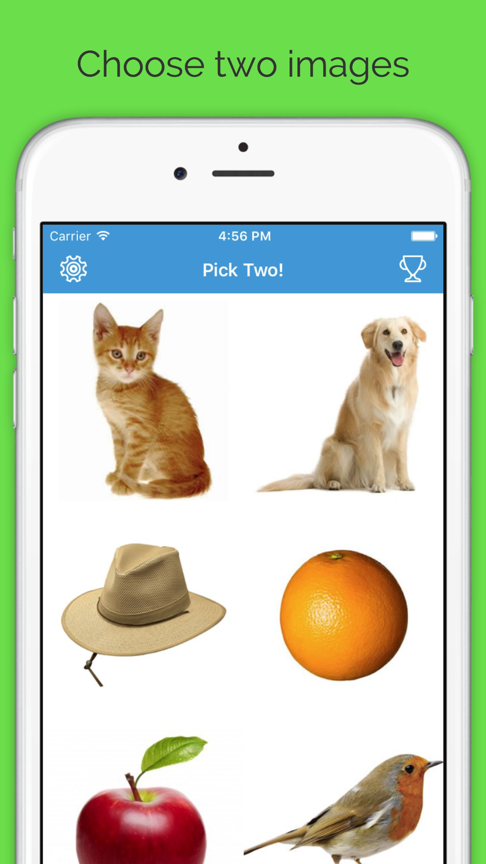
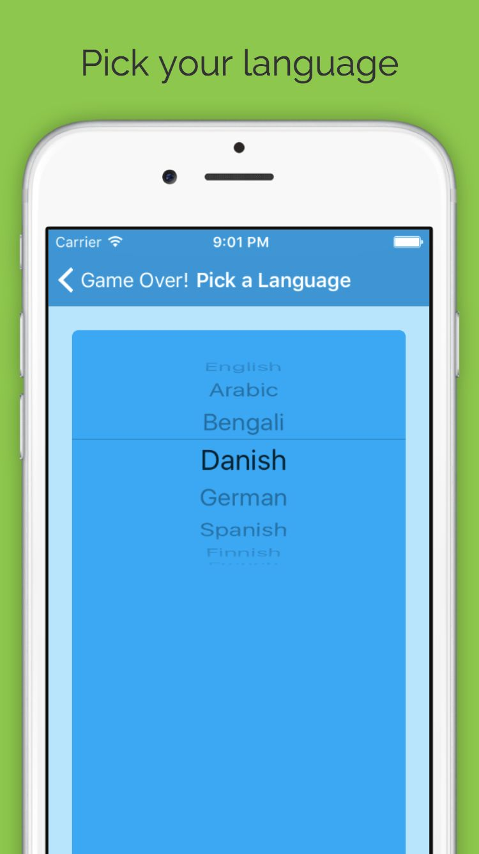
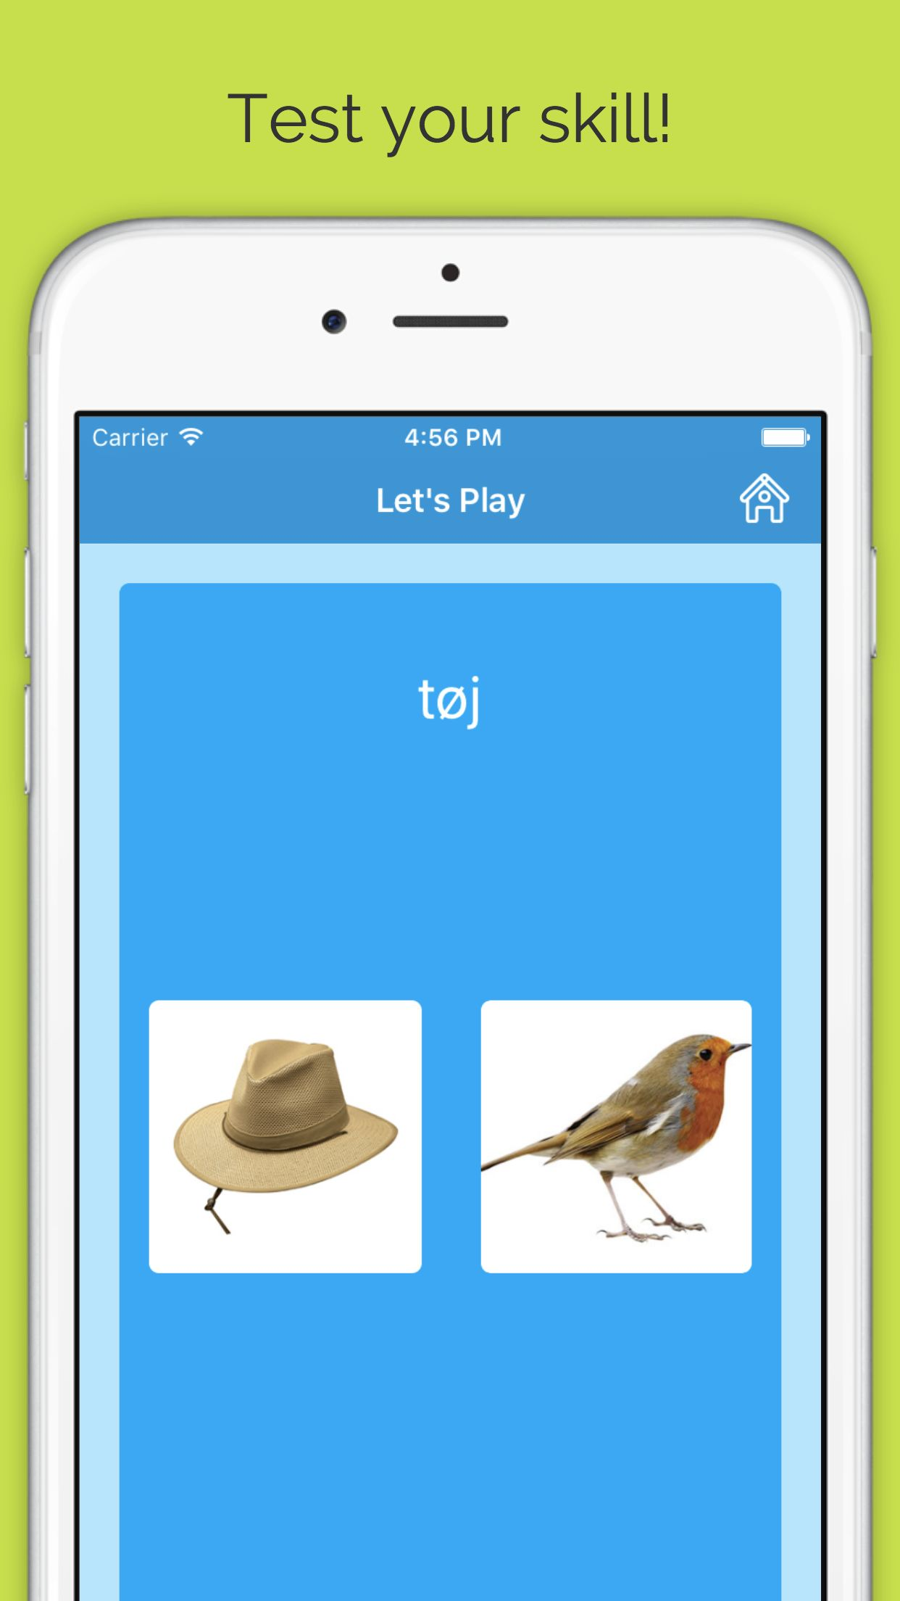
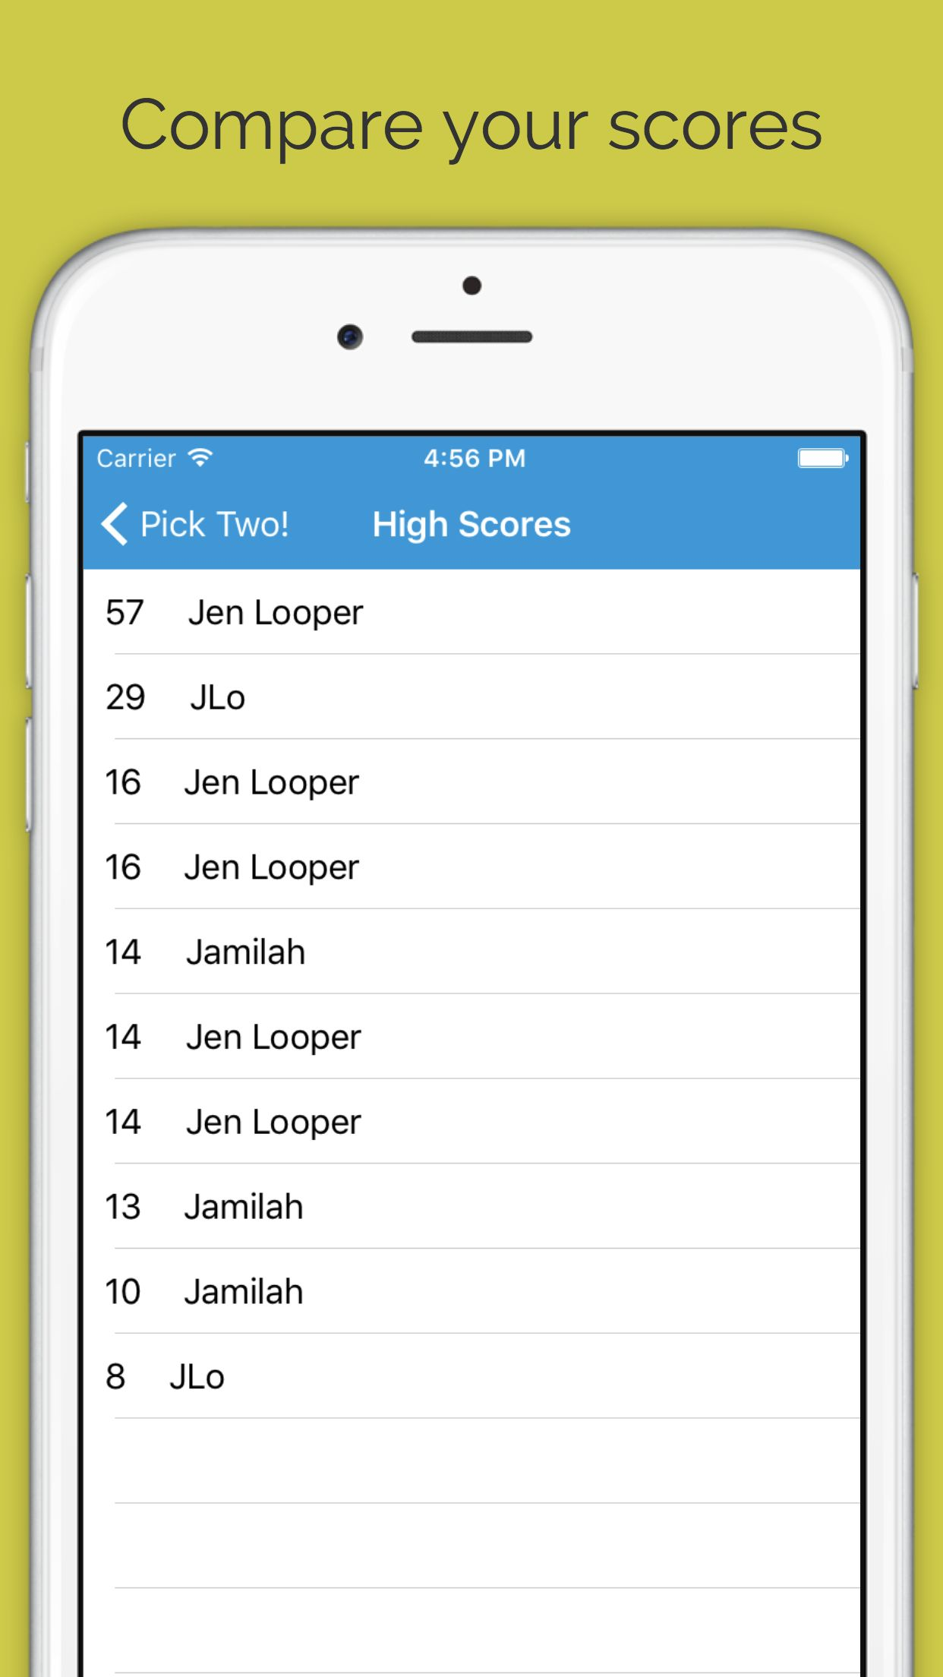
Thisorthat: a game of words and tags

Slide 50
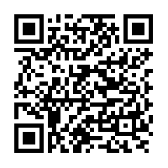
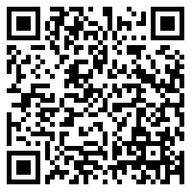
Open source!
Android download
https://github.com/jlooper/thisorthat-app
iOS download

Slide 51
Thisorthat: code walkthrough
Basic structure
API integration
Authentication
View models
Shared code
Animation
Platform-specific code
Cocoapods and Toast plugin
Npm module – email-validator

Slide 52
Thisorthat: Basic Code Structure
Quick code structure rundown

Slide 53
Thisorthat: Api integration
Shared/config.js
Data persistence

Slide 54
Thisorthat: authentication
Login
Password
Register

Slide 55
Thisorthat: View Models
Shared/view-models/game-view-model.js
Shared/view-models/user-view-model.js

Slide 56
Thisorthat: shared code
Shared/navigation.js
Shared/utils/form-util.js

Slide 57
Thisorthat: animation
Nativescript’s built-in animation library

Slide 58
Thisorthat: images
Content-scaled images
Non-content-scaled images

Slide 59
Thisorthat: platform-specific code
CSS
Utils/action-bar-util.js
Utils/form-util.js
Inline: login/login.js

Slide 60
Thisorthat: Cocoapods and npm modules
fancyAlert (YCTutorialBox)
email-validator (generic npm module)
Nativescript-toast (nativescript-based npm modules)

Slide 61
Let’s play!

Slide 62
HMU!
Learn more about NativeScript at the Telerik booth and at nativescript.org
Jen Looper
@jenlooper
jen.looper@telerik.com

